Slide 1
Indexation of Pensions
2022
Dr John Ofori-Tenkorang
A SSNIT presentation
Notes:
More orange in the image

Slide 2
What is Indexation?
Indexation is a technique used to adjust pensions in order to maintain the purchasing power of pensioners
Indexation of Pensions 2022

Slide 3
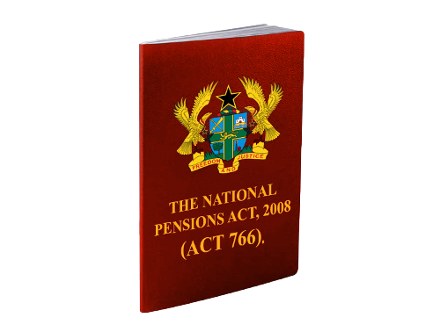
Why Indexation?
1
Legal requirement
2
To preserve the purchasing power of pensioners
Section 80 states that:
“The Trust shall annually review the pension payment which shall be indexed to wage inflation rates of active contributors or another rate determined by the Trust in consultation with the Board of the Authority”

Slide 4
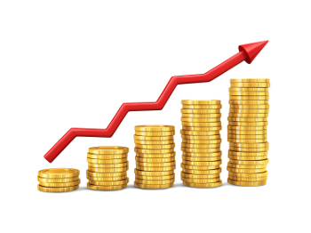
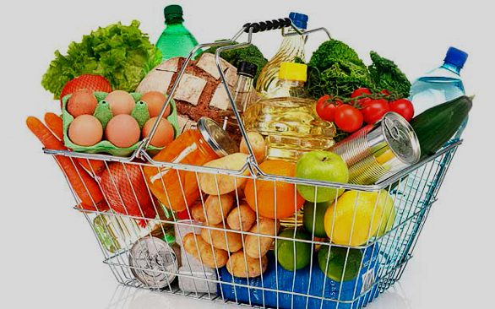
Factors that informed the 2022 Indexation Rate
1
2
Percentage change in the annual average Consumer Price Index (CPI) for 2021
Percentage change in average Wage of Active Contributors in 2021
3
Long term sustainability of the Scheme
4
Liquidity – Ability of the Fund to pay

Slide 5
2022
INDEXATION
RATE
Indexation of Pensions 2022

Slide 6
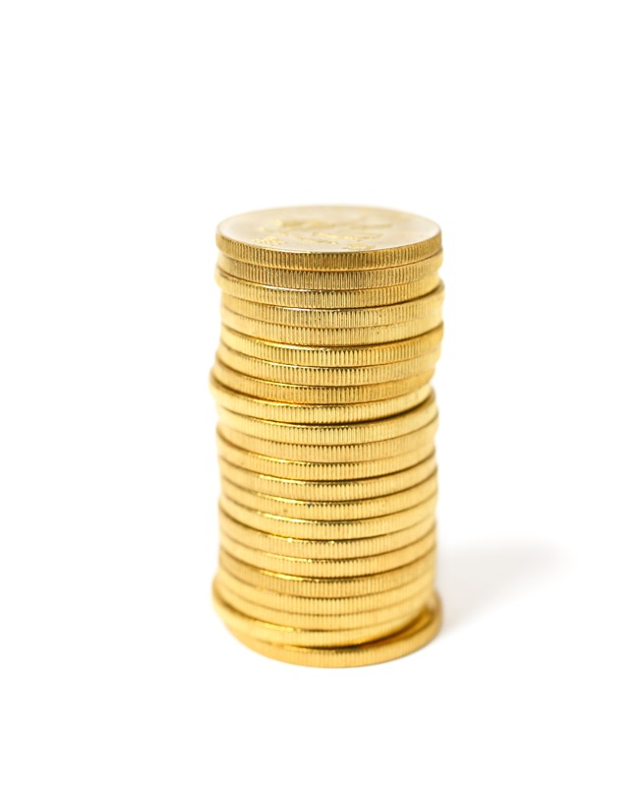
Redistribution of 2022 Indexation Rate
¢
GH¢ 3.44 Flat Amount
9.68%
0.32%
redistributed
Fixed Rate
67% of Pensioners will receive 10% increment or more as a result of the redistribution.

Slide 7
Redistribution of 2022 Indexation Rate
➜
To Cushions low earners
Redistribution is a mechanism that is applied to an indexation rate to cushion members on low pensions in line with the Solidarity Principle of Social Security.
Indexation of Pensions 2022

Slide 8
Minimum Pension for existing Pensioners
GH¢ 332.48
2022
GH¢ 300.00
2021
10.83%
increase of pensions over the 2021 minimum pension.
➜

Slide 9
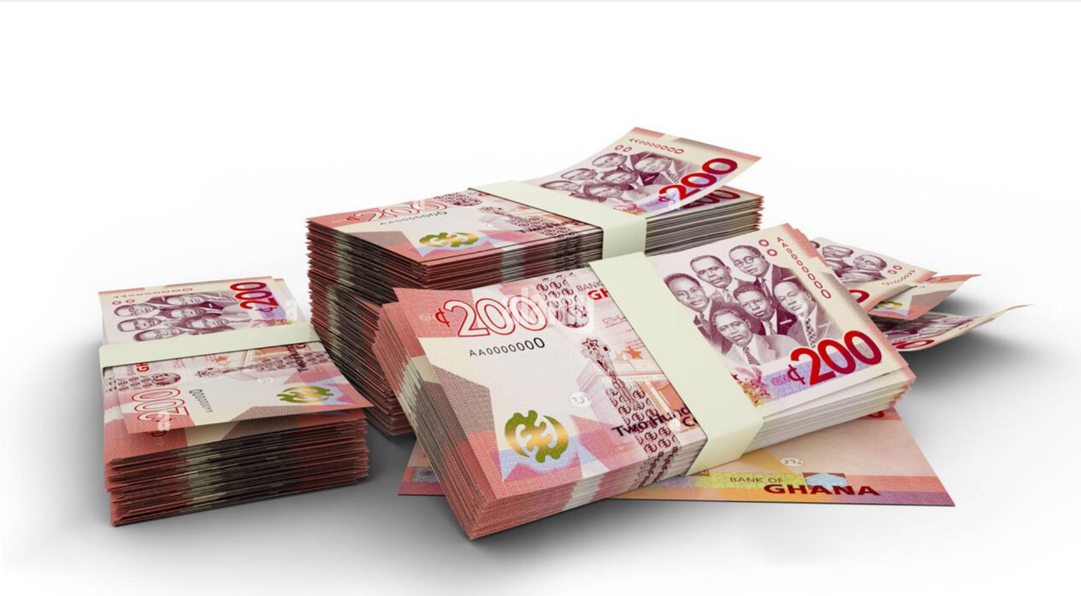
Highest Pension
GH¢ 142,564.97
2022
GH¢ 129,979.51
2021
9.683%
➜
increase over the 2021 highest pension

Slide 10
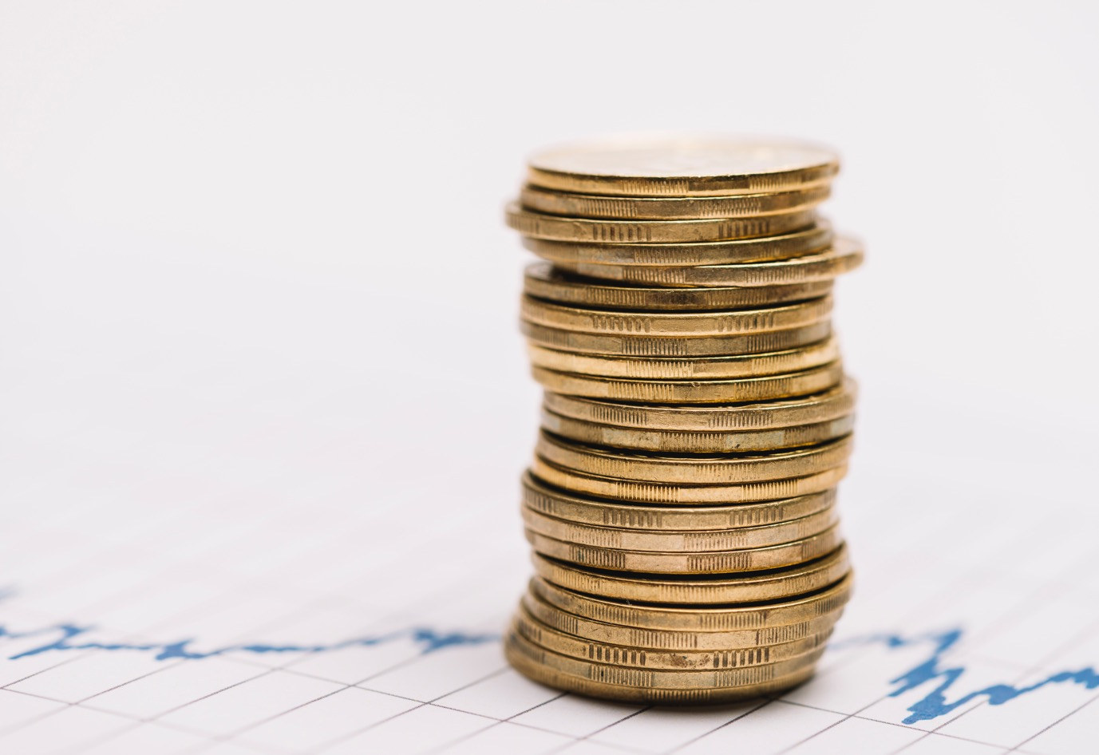
Minimum Pension for new Pensioners (2022)
GH¢ 300.00
This amount is a subsidised pension as a result of very low salaries on which contributions were paid.
Indexation of Pensions 2022

Slide 11
Cost Implication of the 2022 Indexation Rate
ADDITIONAL COST IN PENSION PAYMENTS
GH¢ 243m
GH¢ 308m

Slide 12
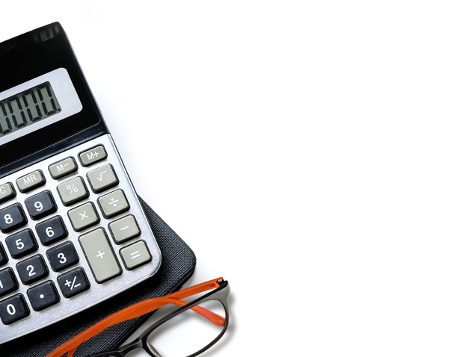
Conclusion
Lowest earning pensioners will get an indexation rate of 10.83%
➜
Management of the Trust will continue to work hard to guarantee positive annual indexation for pensioners bearing in mind the long term sustainability of the Scheme
➜
➜
All pensioners will receive an increase, equal to or above the targeted inflation rate for 2022
➜
The Trust remains committed to paying all legitimate benefits accurately and timeously
➜
The projected expenditure on pension for 2022 is GH¢ 3.5 billion
Indexation of Pensions 2022

Slide 13
SSNIT
is closer than
ever
Indexation of Pensions 2022

